Slide 1
Analysing and comparing student friendly neighbourhoods in USA
A Presentation by Kripa Shankar Muthu Kumar

Slide 2
Contents
Data visualization
Methodology
Results/inference

Slide 3
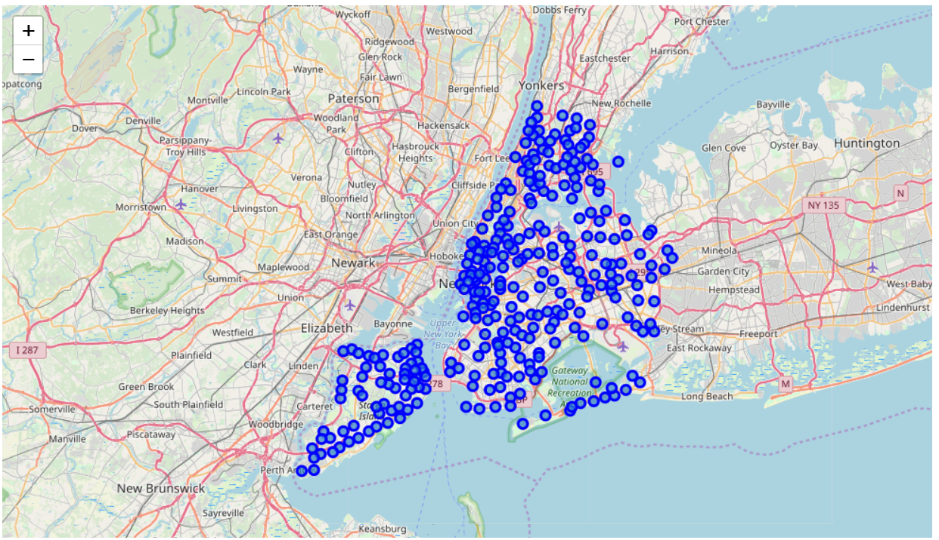
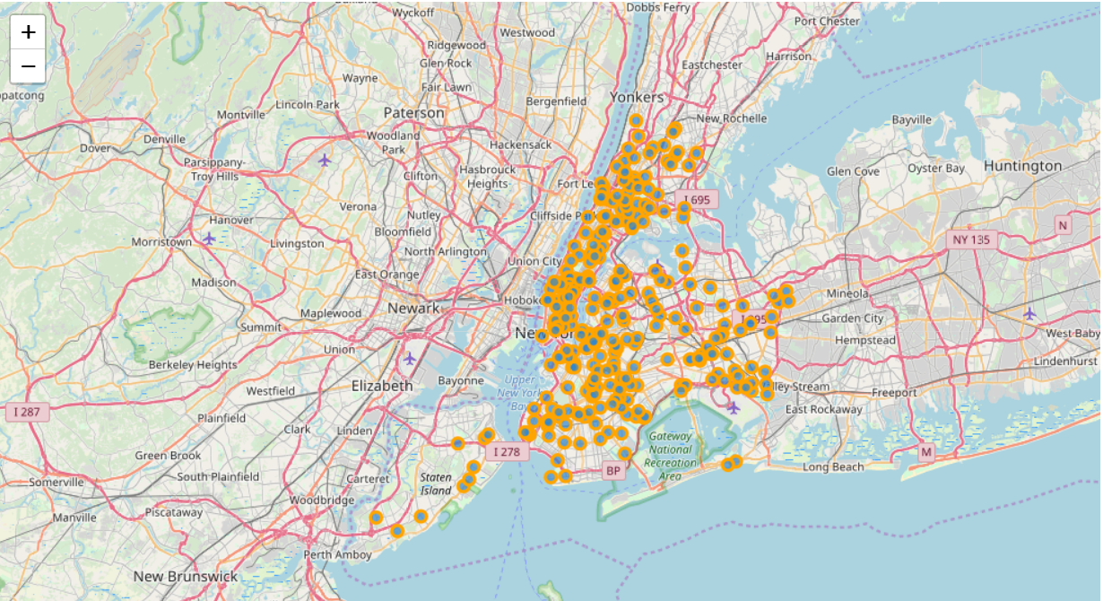
Data visualization
New York Data
Accident data

Slide 4
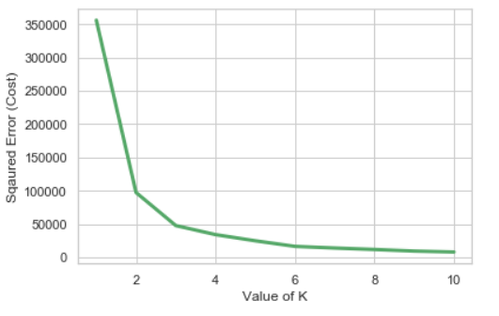
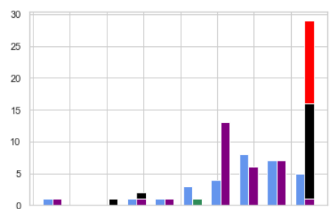
Data visualization

Slide 5
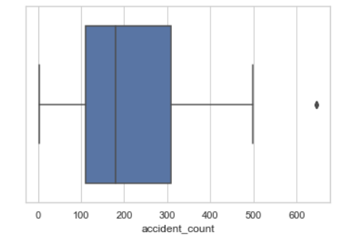
Data visualization (Accident count)

Slide 6
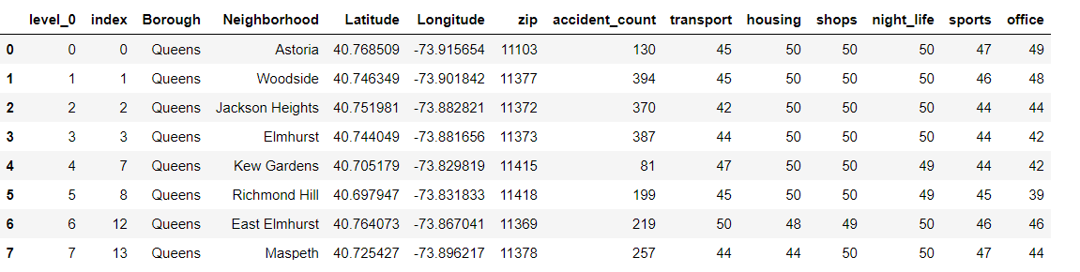
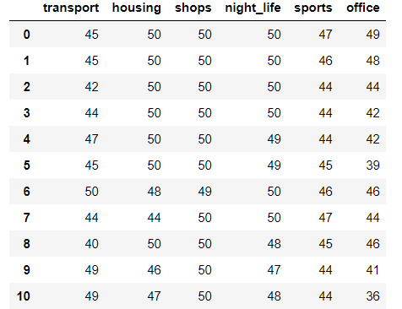
Data collection

Slide 7
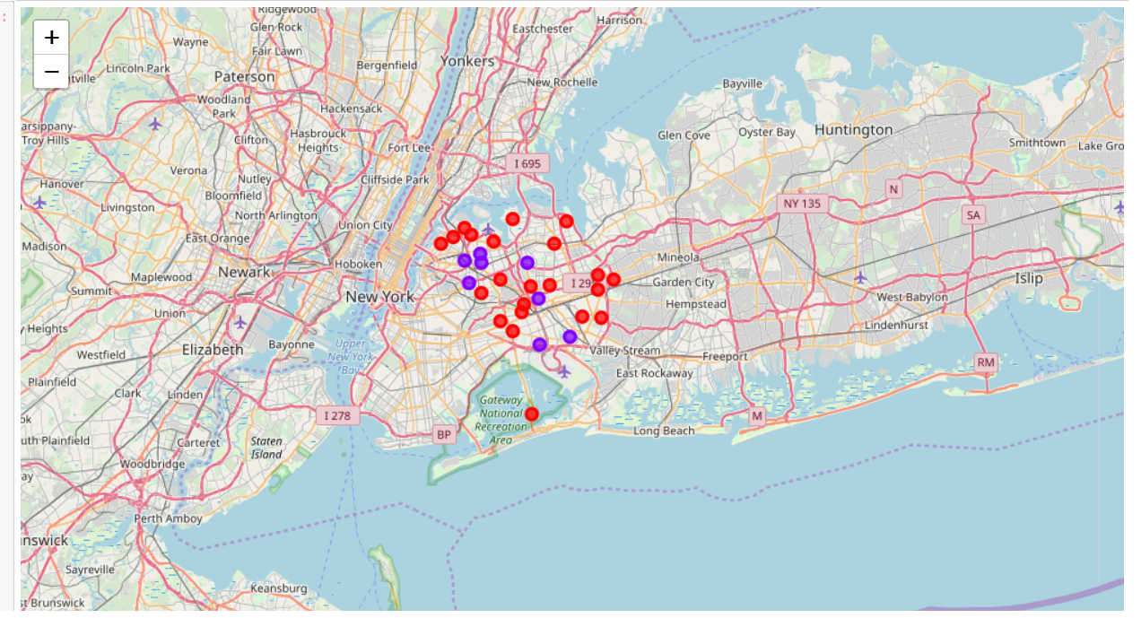
K means clustering (Red – cluster 0, purple- cluster 1)

Slide 8
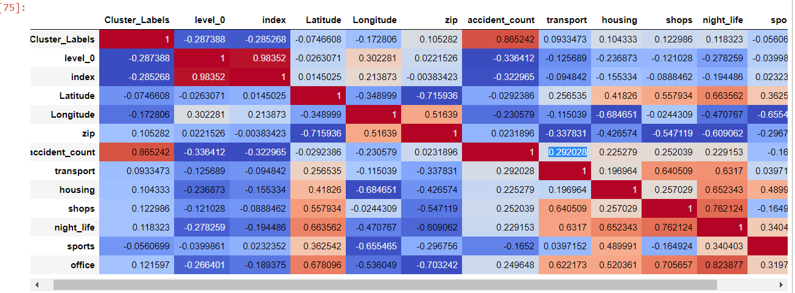
Correlation matrix

Slide 9
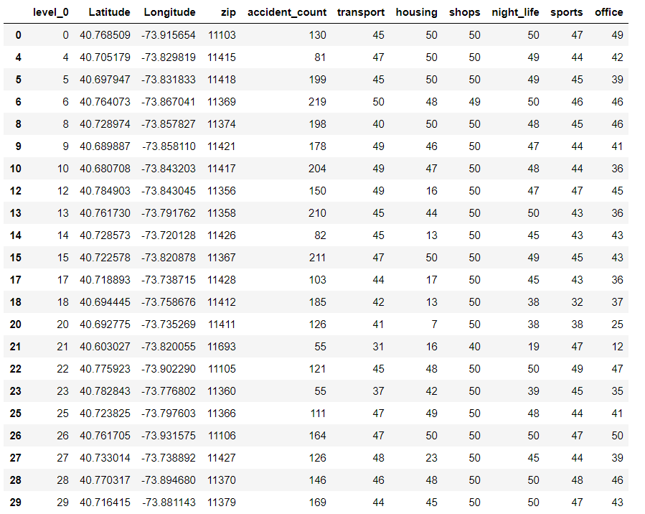
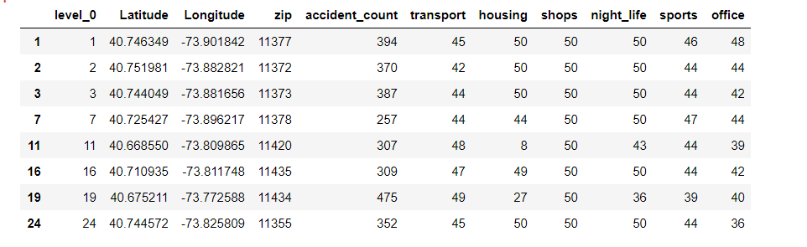
Results
Cluster 0 – less accident areas
Cluster 1 – more accident areas

